Slide 1




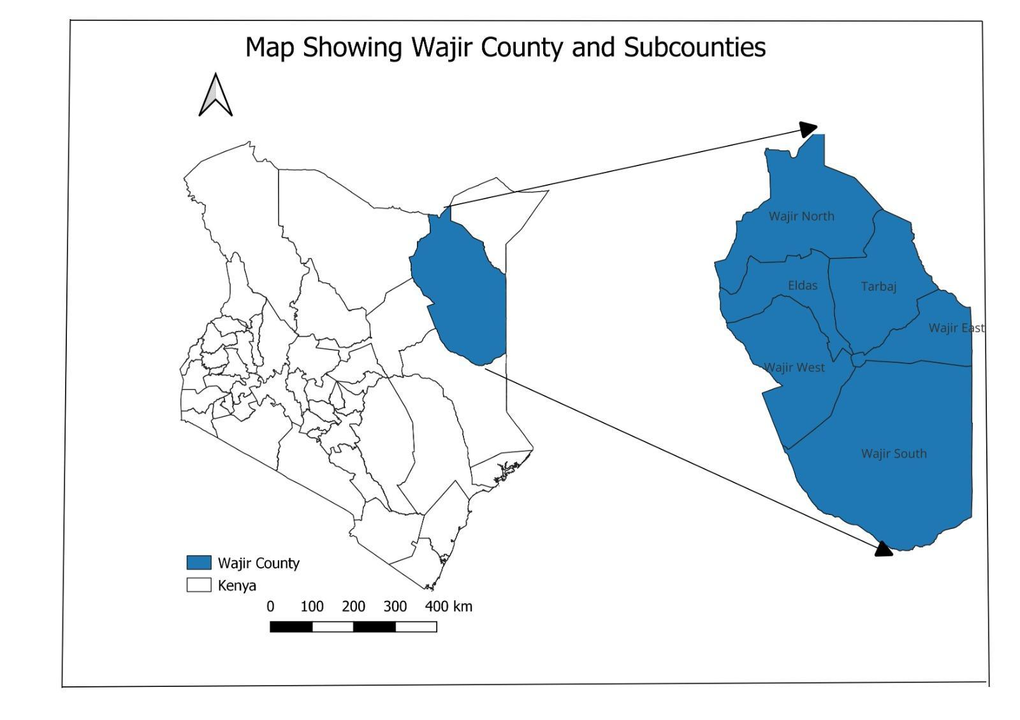
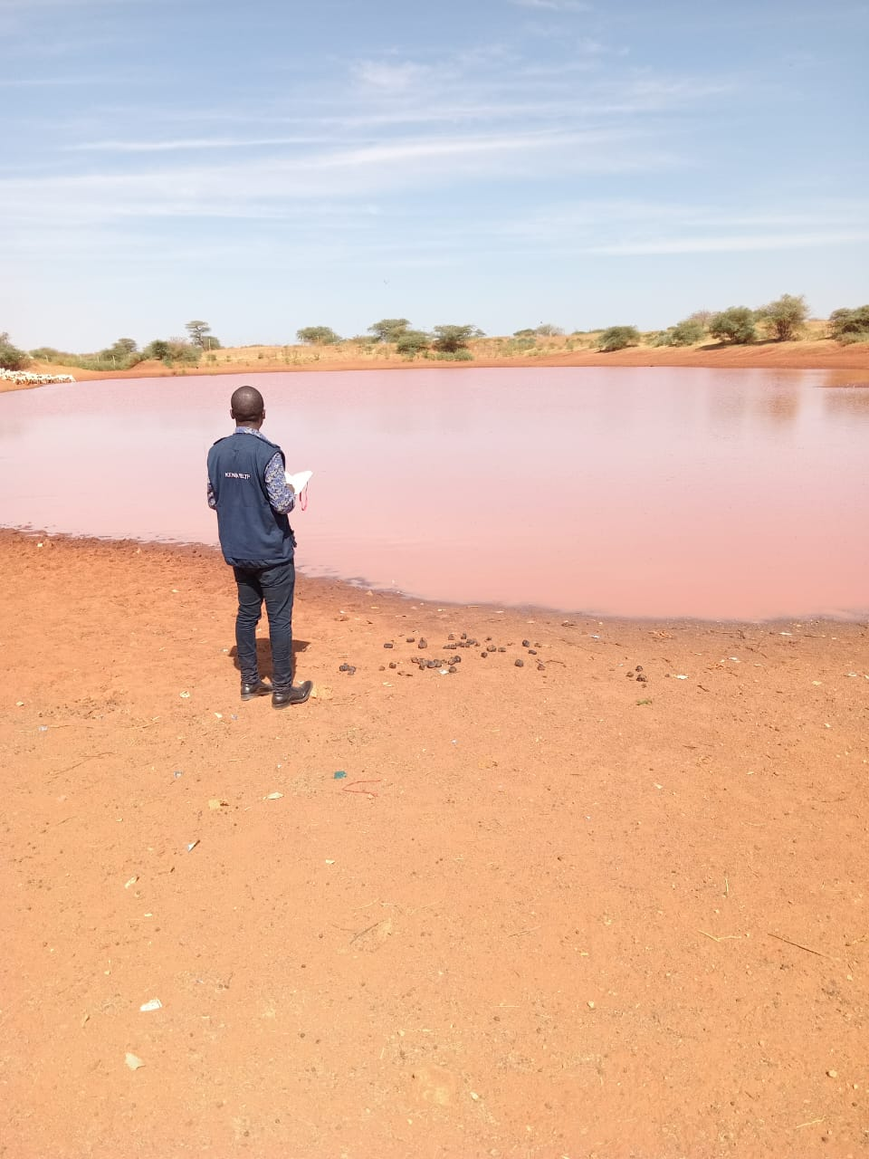
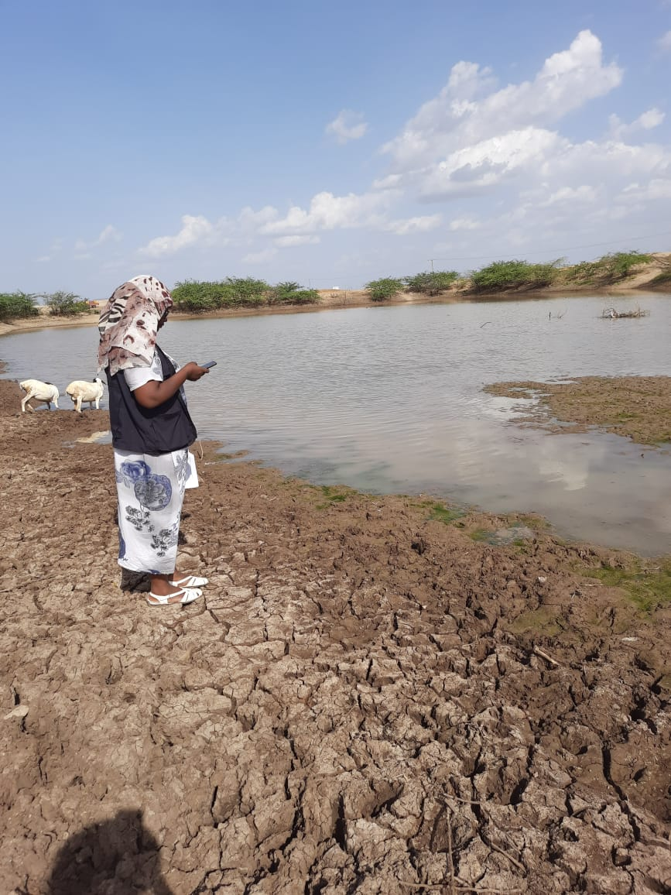
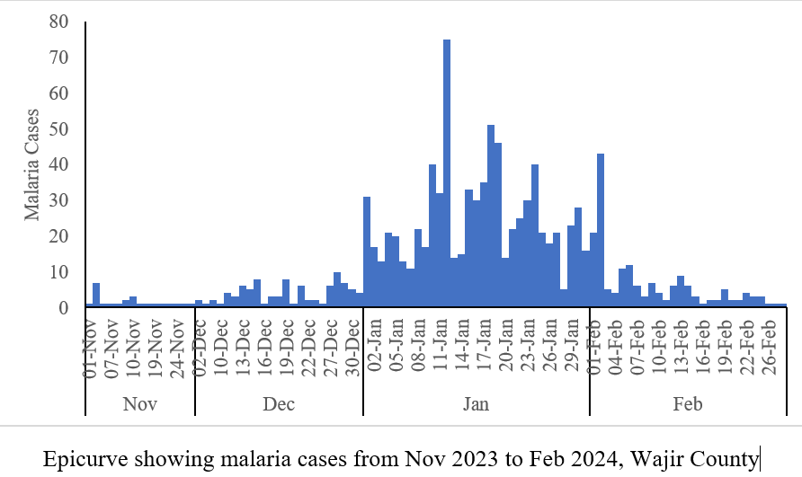
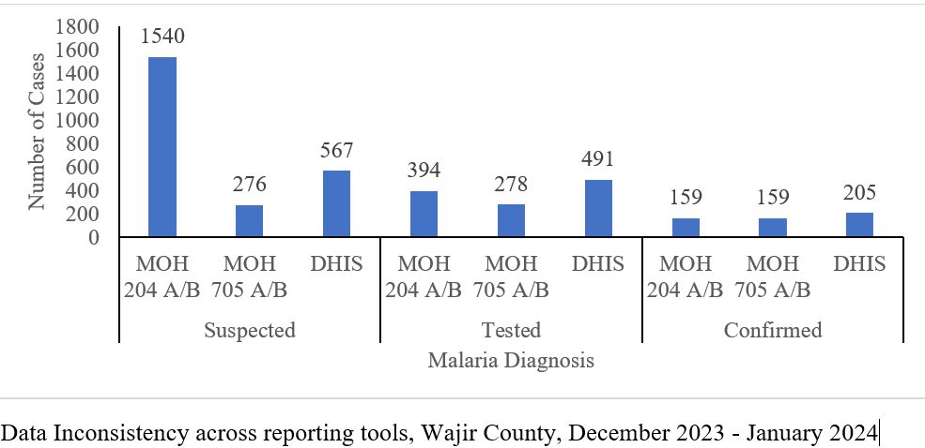
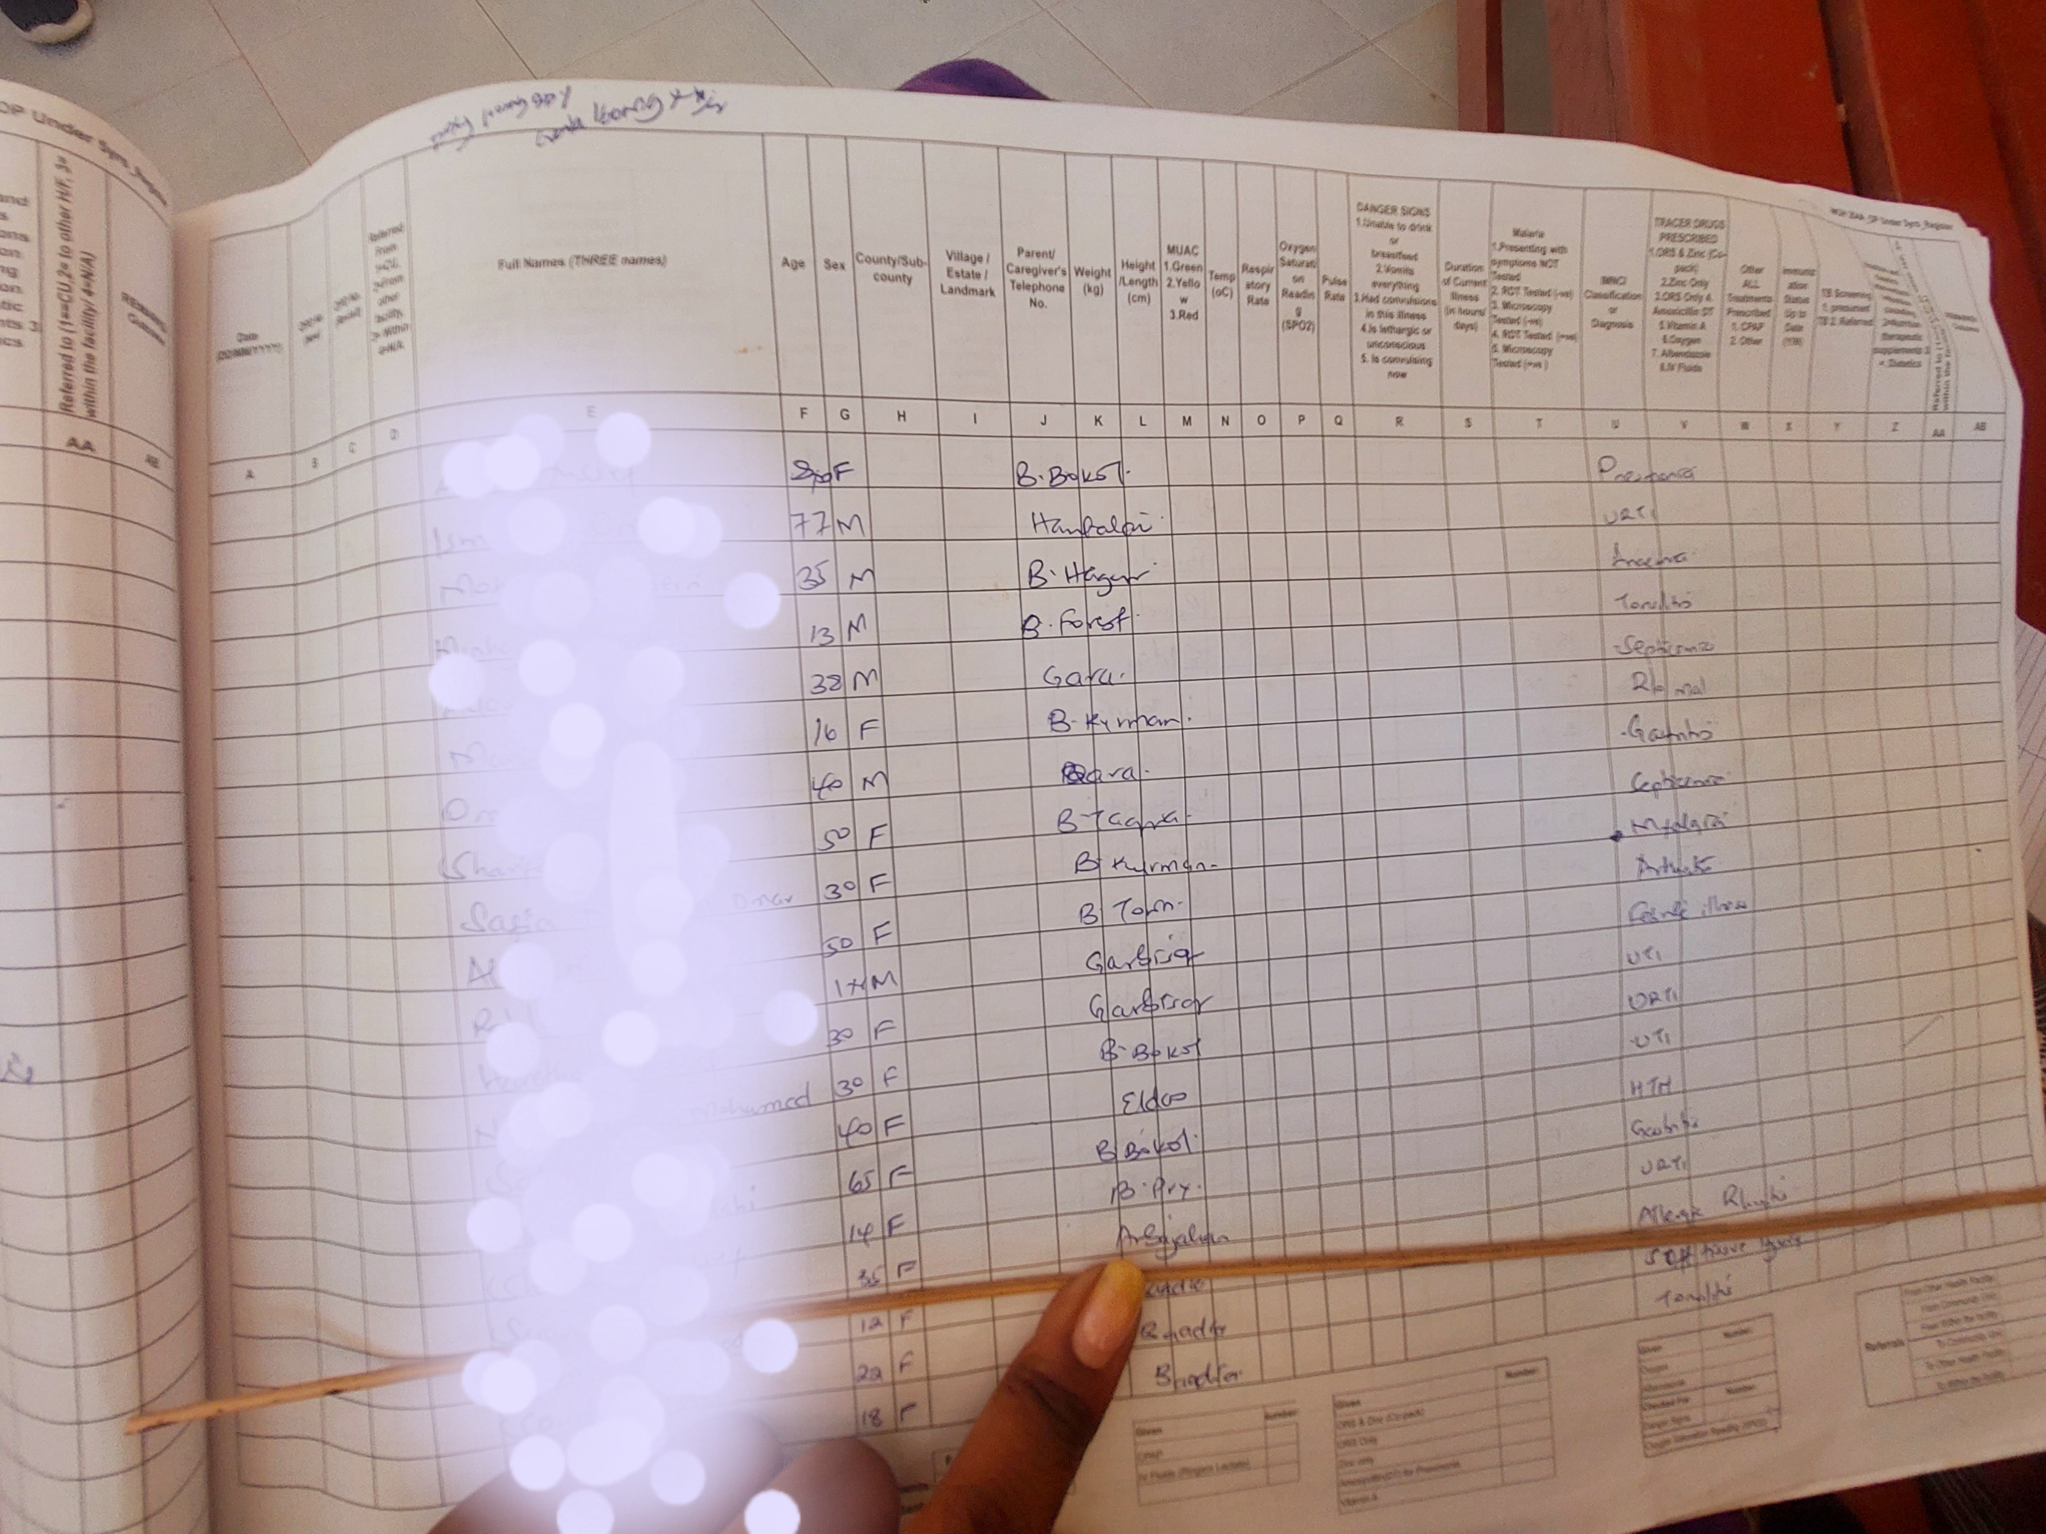
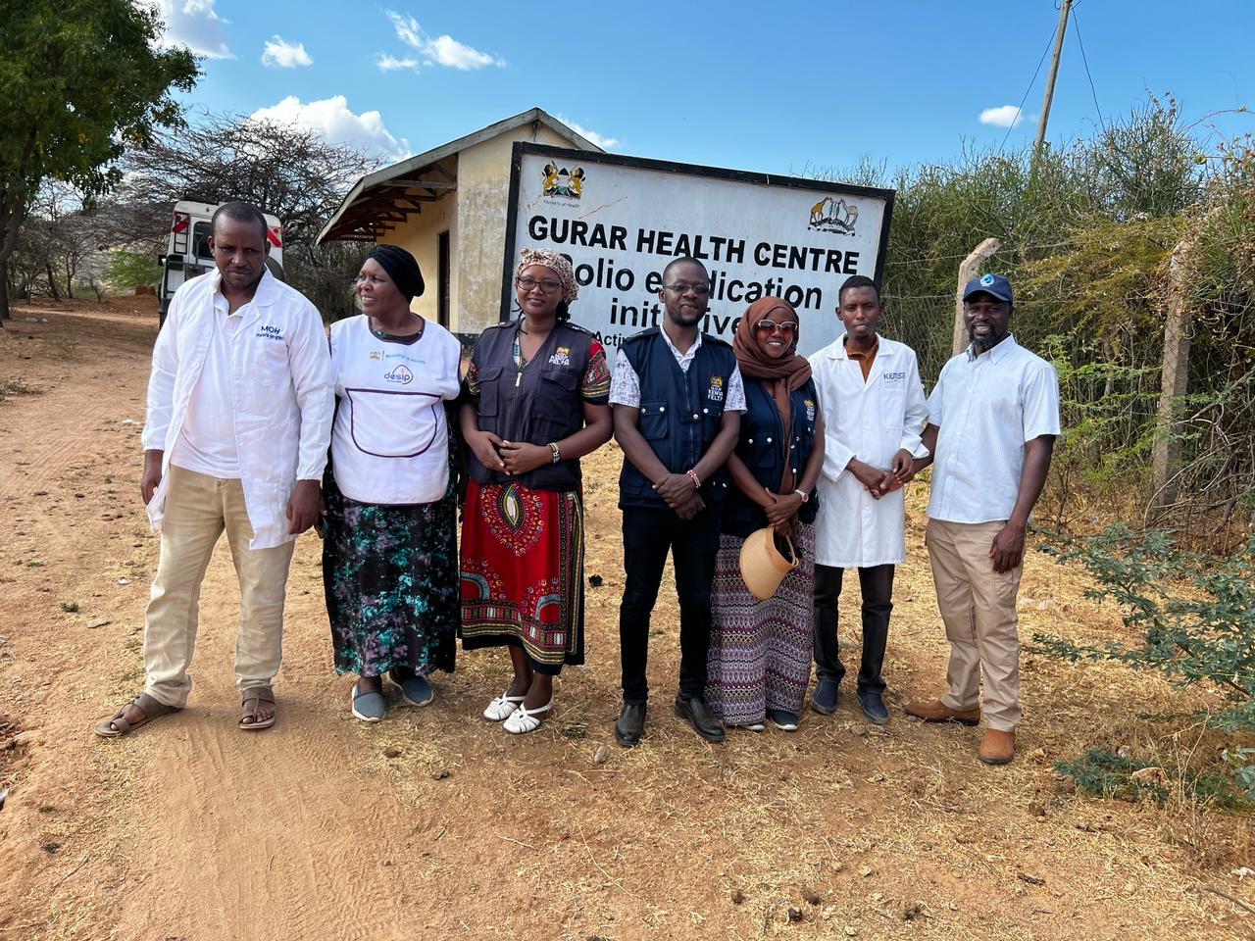
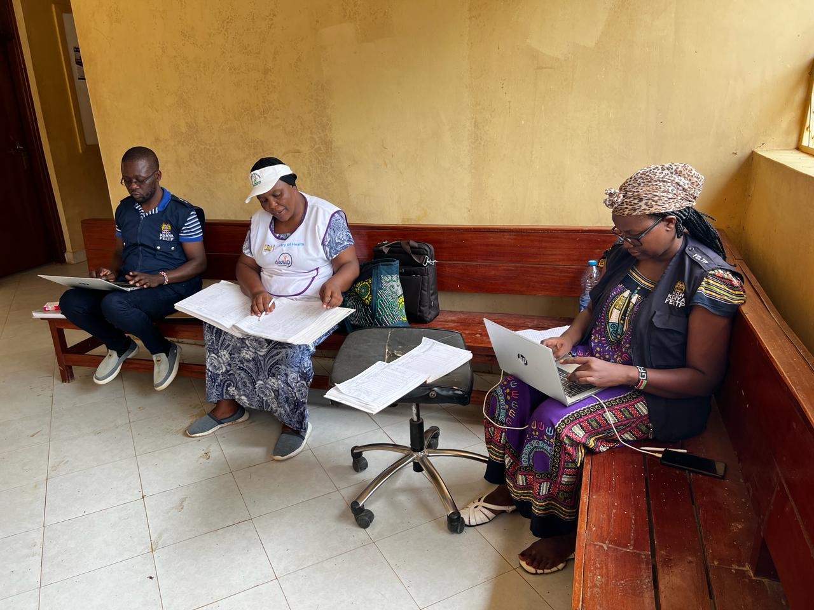


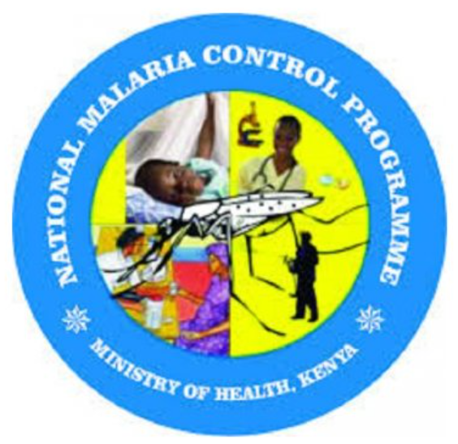
Malaria Surveillance, Outbreak Investigation, Response and Determinant Factors for Severity in the Seasonal Transmission Northern Wajir County, Kenya, 2024
D.Wangari^{1*}, M. Nunga¹, M. Itoh², B. Sigu¹, N. Kileku¹, R. Ajambo³, B. Machini⁴, A. Abade¹, J. Hines¹, M. Owiny¹
¹Kenya Field Epidemiology and Laboratory training program, Ministry of Health, Nairobi, Kenya , ²U.S. President’s Malaria Initiative, US Centers for Disease Control and Prevention, Nairobi, Kenya, ³Wajir County Health Department, Ministry of Health, Kenya, ⁴National Malaria Control Program, Ministry of Health, Nairobi
BACKGROUND
The Kenya Malaria Strategy aims to reduce malaria incidence by 80% of 2023 levels by 2028
Emerging threats such as Climate change, new vectors, and new parasites are major hindrances to achieving this goal
In January 2024, Wajir County, situated in Northern Kenya and considered a low-malaria-transmission zone, reported a >30-fold surge in malaria cases.
Rainfall in Oct–Nov 2023 (2992mm) was significantly more than the same period in 2022 (110mm).
OBJECTIVE: An outbreak investigation was carried out to characterize cases and implement control measures
METHODOLOGY:
Data of confirmed malaria cases were collected from Nov 2023–Feb 2024 from 38 health facilities that reported confirmed malaria cases above the thresholds.
Inpatient malaria cases were a proxy for severe malaria.
Descriptive and bivariate analyses of the factors associated with severe malaria were conducted.
Verification factor (VF), the ratio of confirmed malaria cases recorded in health facility registers to the number of malaria cases in the national health information database, was used to assess data accuracy
Allowing a 10% margin of error, VF < 90% were considered over-reporting, while VF > 110 was under-reporting
STUDY AREA: Wajir, Kenya
DISCUSSION
STATISTICAL ANALYSIS:
RESULTS
The majority of the malaria cases were males and over 5 years old, possibly linked to cultural practices in a nomadic pastoralist
New parasites, such as P.vivax, call for new diagnostics and unavailable treatment strategies in Wajir
Nearly half of the malaria cases were seen in private facilities, which do not report monthly to the KHIS. These facilities lack the recommended registers and monthly reporting tools; therefore, most cases are missed in the system
Data discrepancies across all levels were noted. Poor filling of registers, high staff turnover and lack of mentorship were some reasons the healthcare workers cited.
x
CONCLUSIONS
Socio-demographic and Clinical Characteristics of Malaria Cases, Wajir County, Nov-Jan 2024
Variable |  | Frequency | Percent % | 95% C. I
Sex | Female | 372 | 34.35 | 31.58 - 37.23
 | Male | 711 | 65.65 | 62.77 - 68.42
Age | <5 years | 147 | 13.57 | 11.66 - 15.74
 | ≥ 5 years | 936 | 86.43 | 84.26 - 88.34
Residence | Eldas | 231 | 21.33 | 18.99 - 23.87
 | Tarbaj | 44 | 4.06 | 3.04 - 5.41
 | Wajir East | 71 | 6.56 | 5.23 - 8.19
 | Wajir North | 553 | 51.06 | 48.09 - 54.03
 | Wajir South | 8 | 0.74 | 0.37 - 1.45
 | Wajir West | 176 | 16.25 | 14.17 - 18.57
Care | In patient | 118 | 10.90 | 9.18 - 12.89
 | Out patient | 965 | 89.10 | 87.11 - 90.82
Species | P.Falciparum | 967 | 89.29 | 87.31 - 90.99
 | P.Malariae | 83 | 7.66 | 6.22 - 9.40
 | P.Ovale | 1 | 0.09 | 0.02 - 0.52
 | P.Vivax | 32 | 2.95 | 2.10 - 4.14
Data Discrepancies were attributed to improperly filled-out registers.
Those in the lowlands were at increased risk of severe malaria.
Plasmodium vivax detected could imply cross-border transmission.
We recommend improving data quality for surveillance
Tailored Malaria intervention strategies for different subcounties
There were two deaths (Case fatality rate 1.68%).
The odds of developing severe malaria were higher in the southern lowlands (OR- 2.12, CI 1.42-3.16) than in the Northern Hilly areas.
A VF 63% was noted.
Contact: dr.wangarimwaura@gmail.com

